Slide 1

Getting Help
This section provides you with instructions on how to get help and report problems.

Slide 2
Help Resources
Runtime sources
  --help, --modhelp module[:class]
SF Wiki
  Best documentation
  Searchable and you can make edits
SF Forums
  Questions not covered by Wiki
  All users see answer
SF user emails
  Ok, but not always quick
  Other users don’t benefit from answer

Slide 3
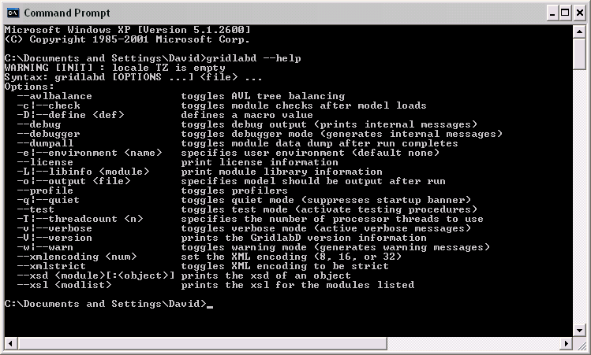
Example: --help option

Slide 4
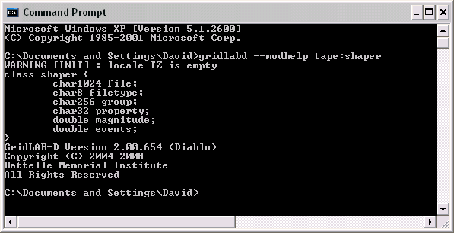
Example: --modhelp tape:shaper

Slide 5
Example: --modhelp powerflow:line
class line {
parent link;
class link {
parent powerflow_object;
class powerflow_object {
set phases; // {A, B, C, D, N, S, G}
double nominal_voltage [V];
};
enumeration status; // {OPEN, CLOSED}
object from;
object to;
double power_in [W];
double power_out [W];
};
object configuration;
double length [ft];
}

Slide 6
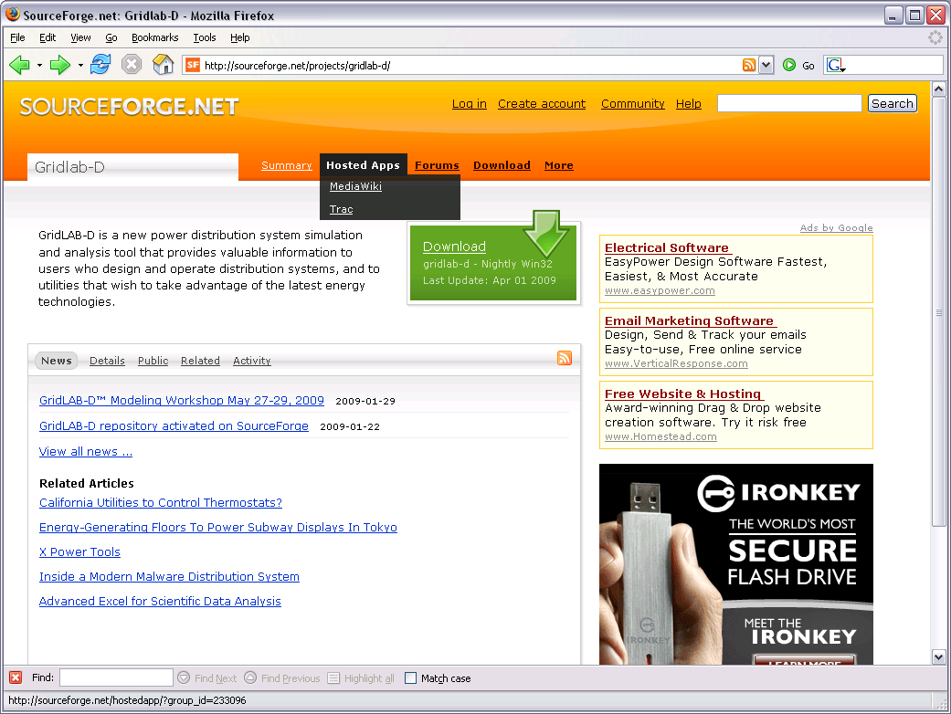

Slide 7
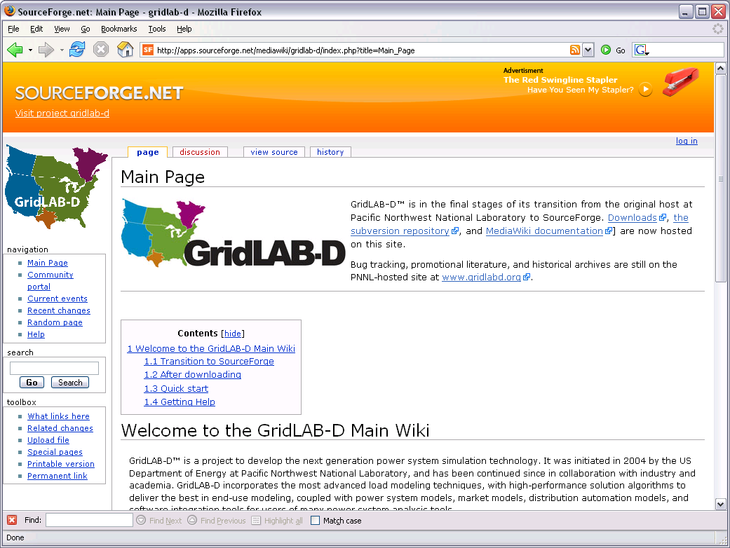

Slide 8
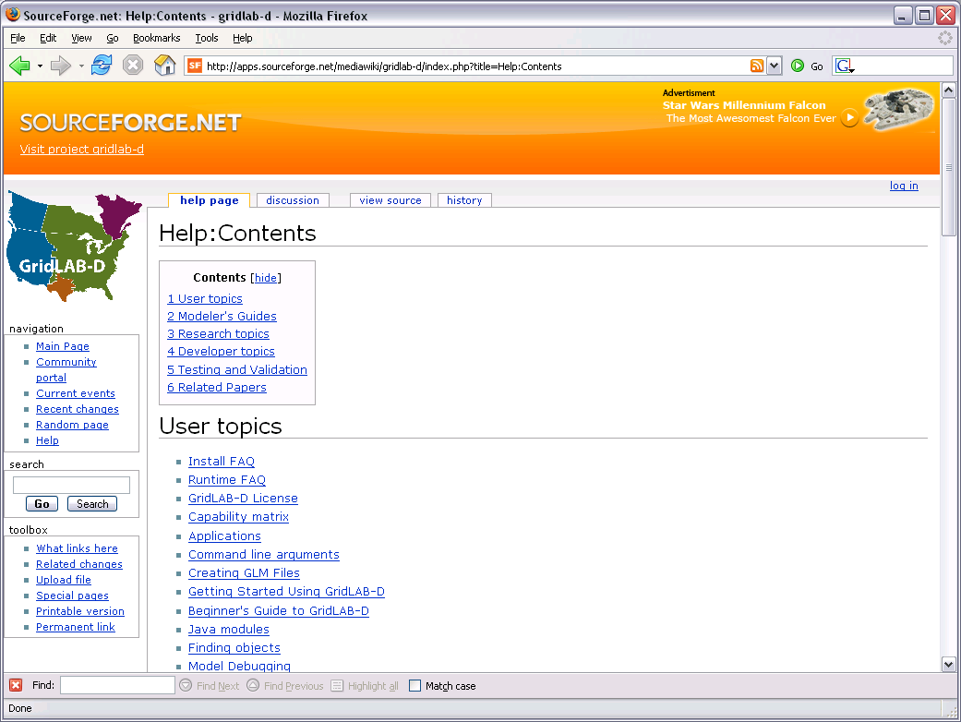

Slide 9
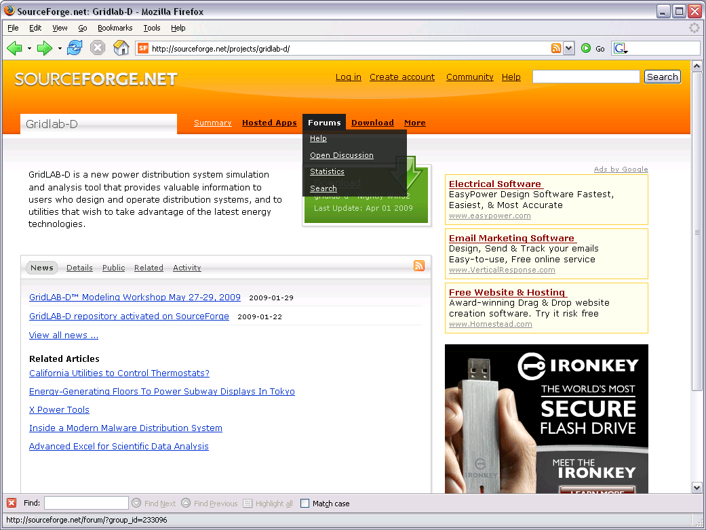

Slide 10
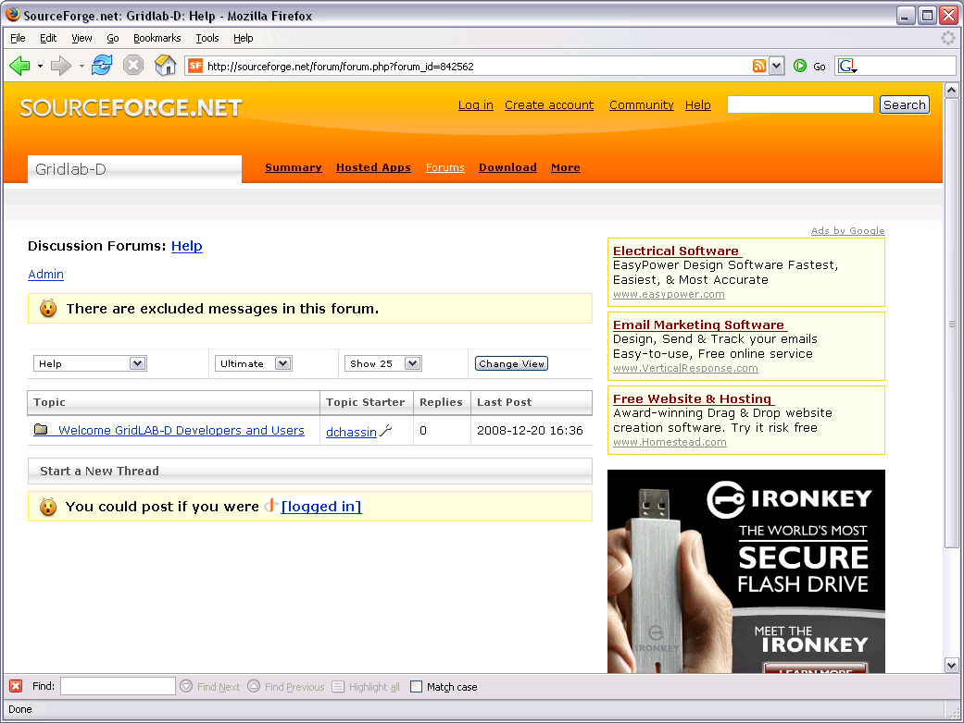

Slide 11
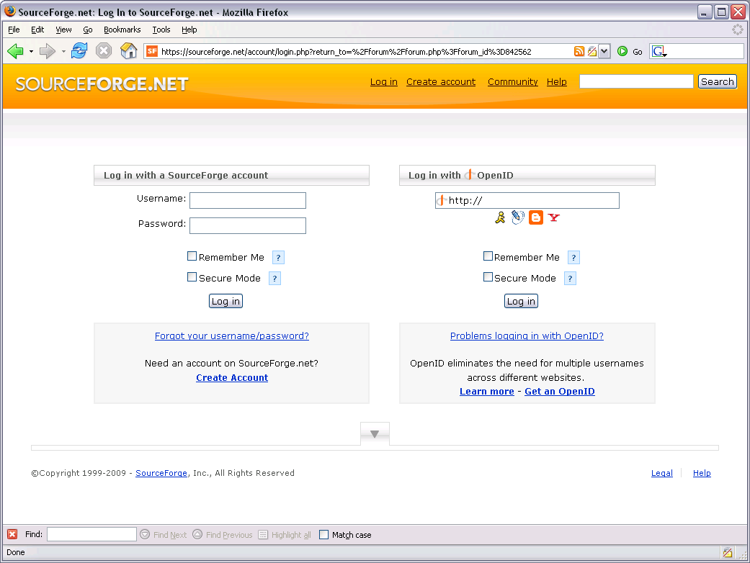

Slide 12
Reporting problems
SF TRAC system
  Routes and tracks problems/solutions/fixes
Tips for effective bug reporting
  Make sure you search wikis and forums first
  Reduce problem to simple example
  Post the example with the report
  Log in so we know who found the problem

Slide 13
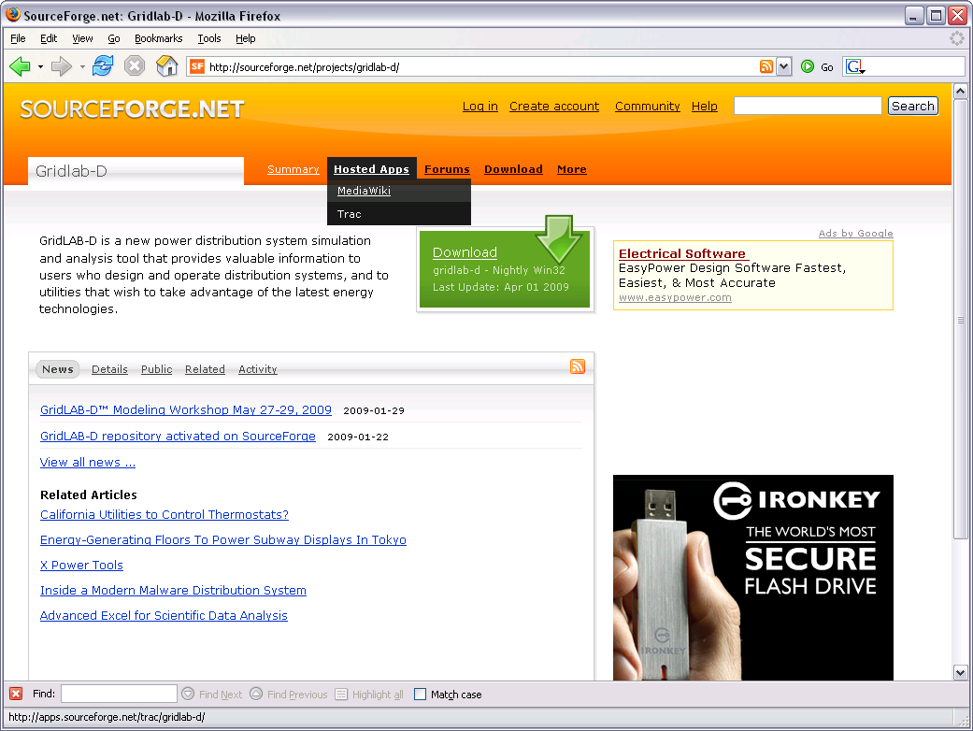

Slide 14
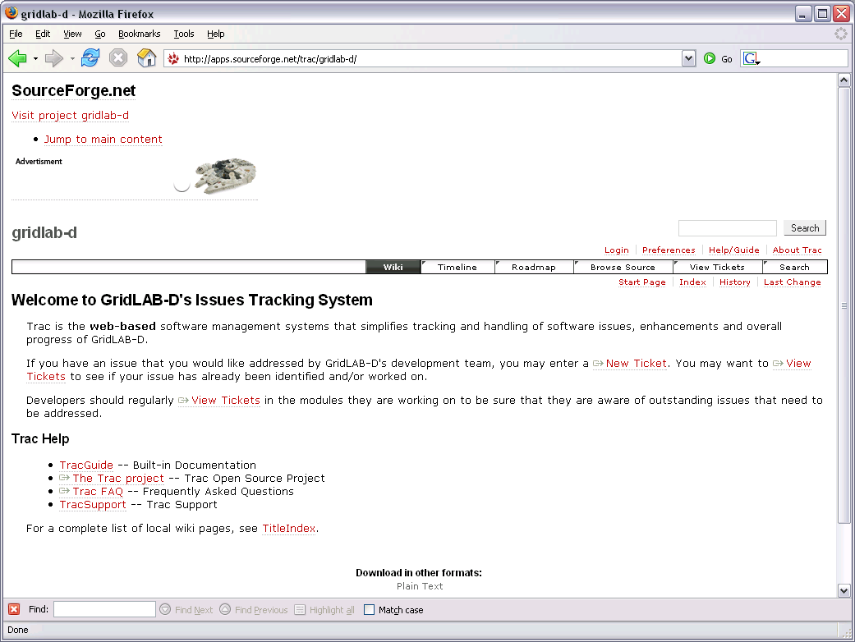

Slide 15
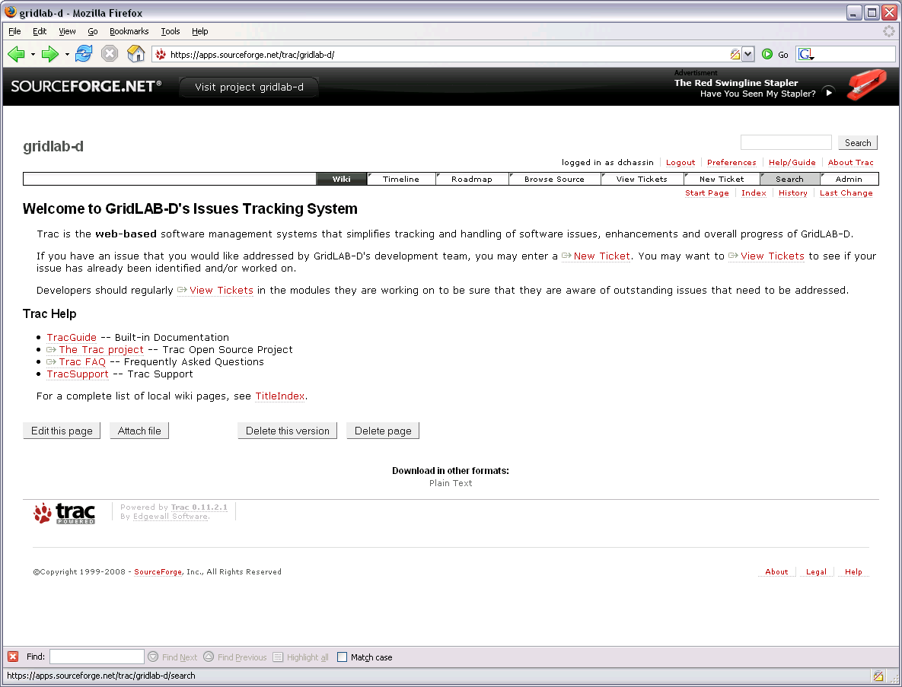

Slide 16
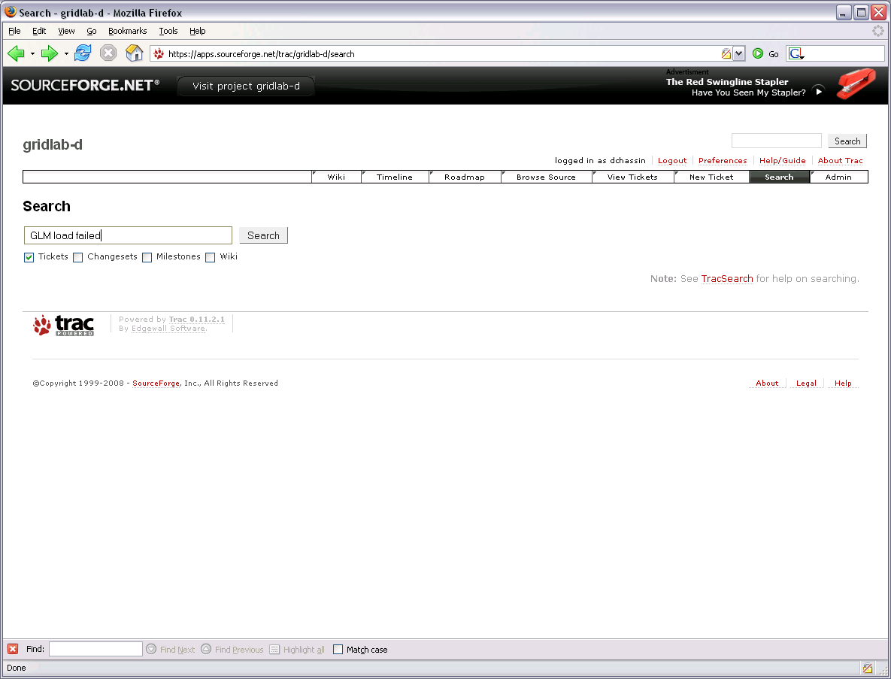

Slide 17
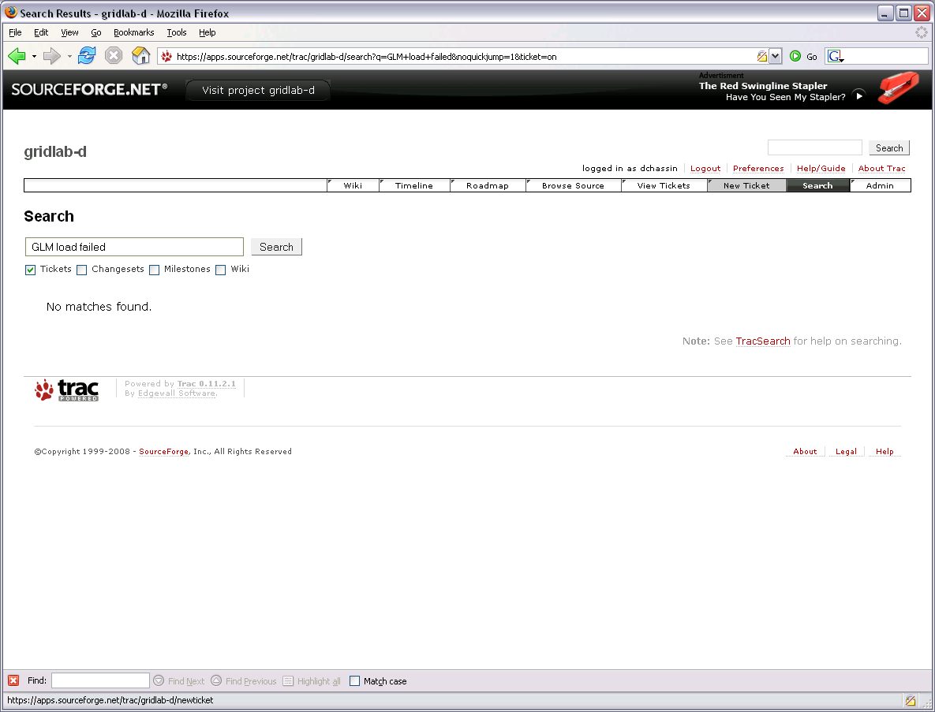

Slide 18
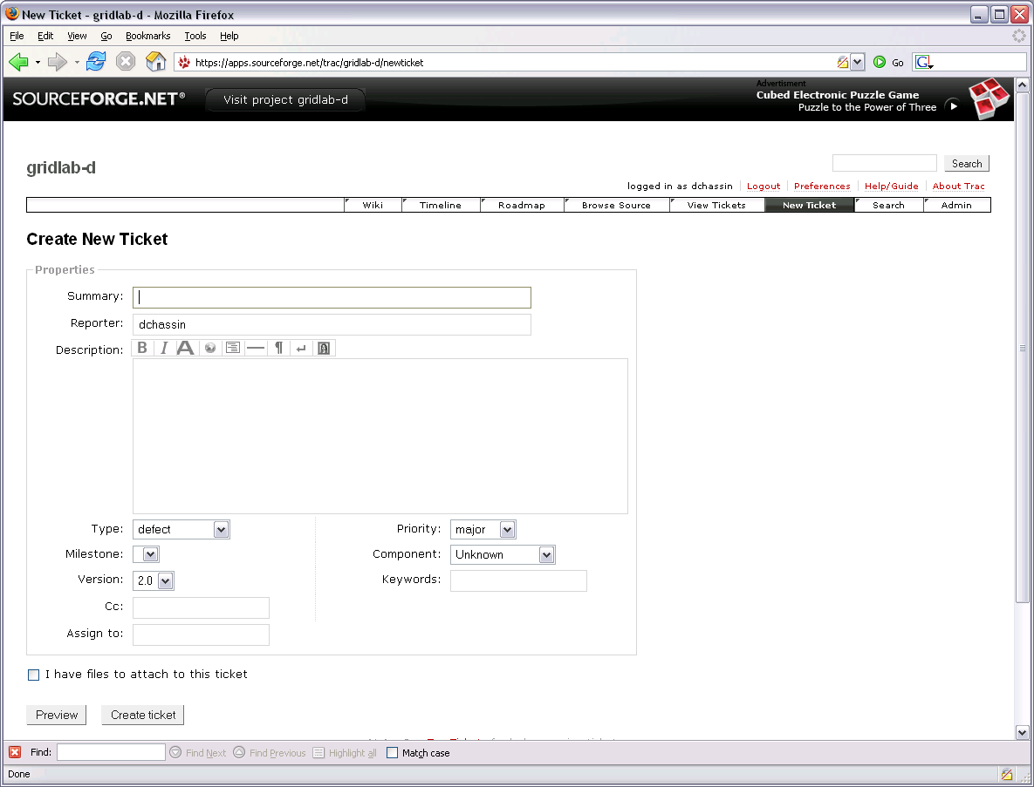

Slide 19
Exercises 1.4
Can histogram objects use non-uniform bins?
Can you guess how to get help from the command line?
You found a problem where F4 doesn’t work when the #error macro is used. Search TRAC for similar reports.

